Slide 1
Thought Bubble Diary
- By Thompson

Slide 2
What is it?
Thought Bubble is a diary application developed for Android
The app manages users and allows them to jot down quick ideas
You can use this app as a your personal diary

Slide 3
What does it do?
Creates user
Authenticates users
Makes diary entries
Saves entries into the database encrypted
Reads and manages diary entries with great deal of security

Slide 4
Features
USES SHA-1 HASHING ALGORITHM TO HASH USER PASSWORDS
COMPARES HASHES AT LOGIN
ENCRYPTS DIARY ENTRIES USING AES-256 ALGORITHM

Slide 5
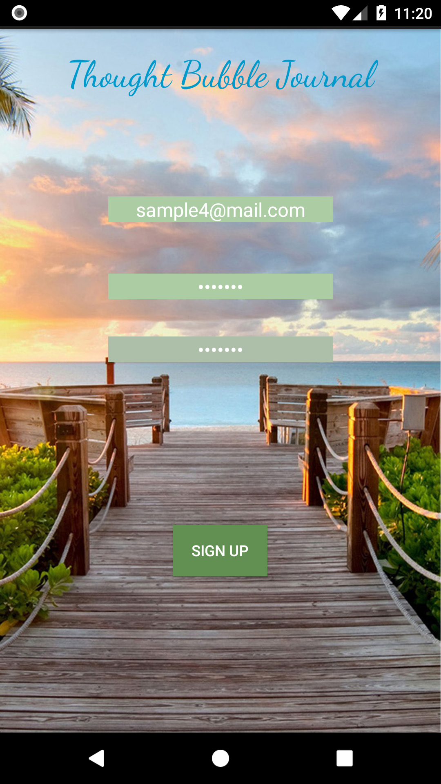
The signup activity
VALIDATES EMAIL AND PASSWORD
SAVES THE EMAIL AND SHA -1 SIGNATURE OF THE PASSWORD INTO THE DATABASE
CHECKS FOR UNIQUE EMAIL ID CONSTRAINTS

Slide 6
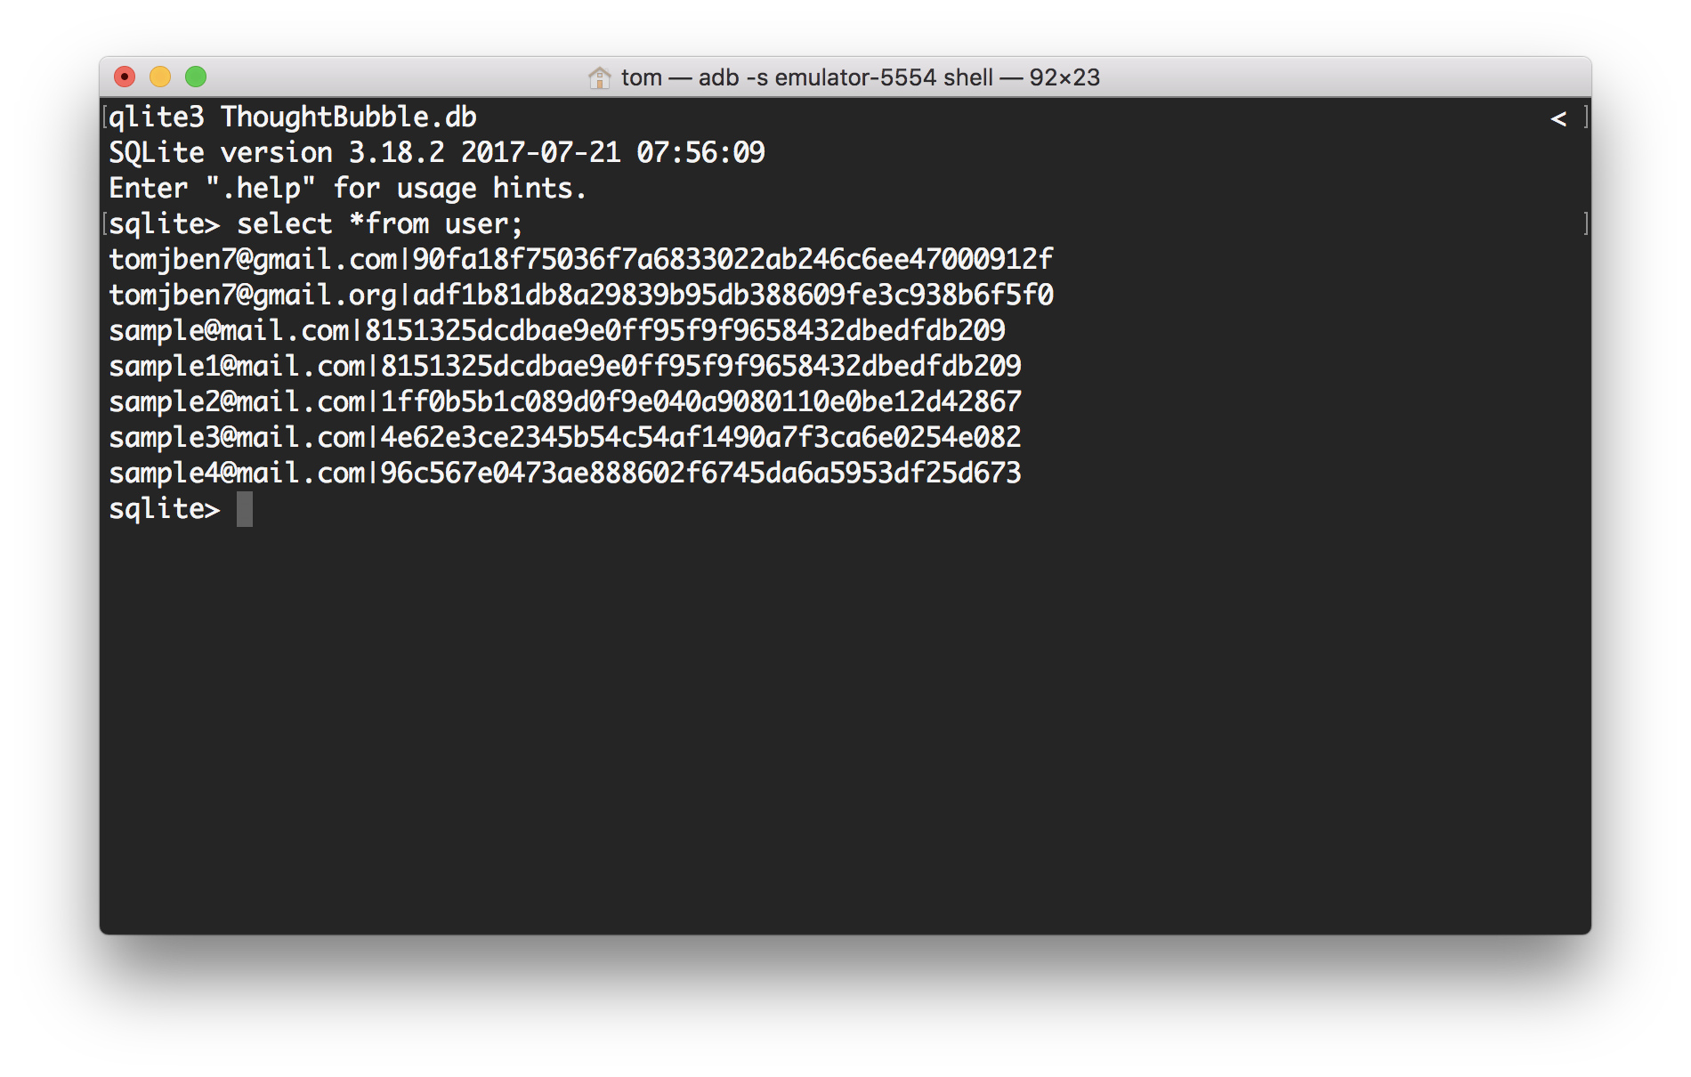

USER SIGNS UP

Slide 7
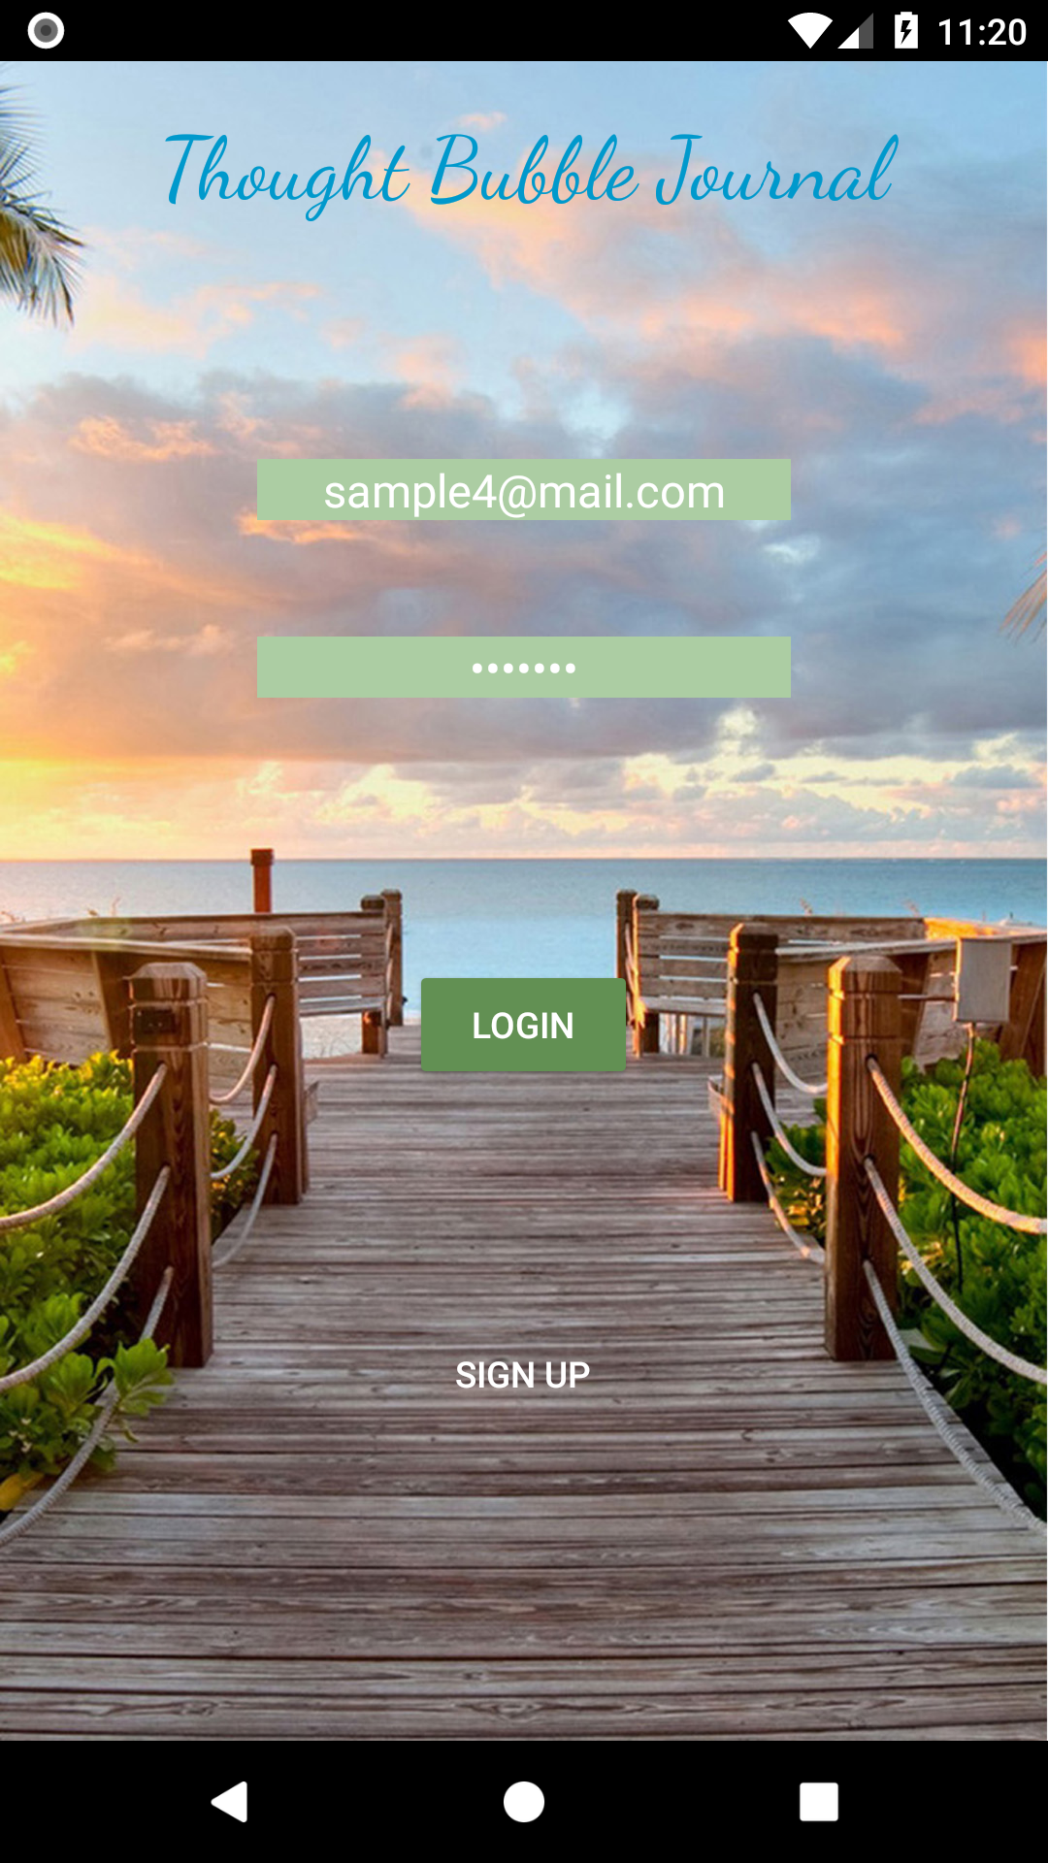
USER LOGS IN
VALIDATES EMAIL AND PASSWORD
GETS THE SHA-1 SIGNATURE OF THE PASSWORD AND COMPARES THEM WITH THE SIGNATURE STORED IN THE DATABASE
IF MATCHED, USER IS LET THROUGH

Slide 8
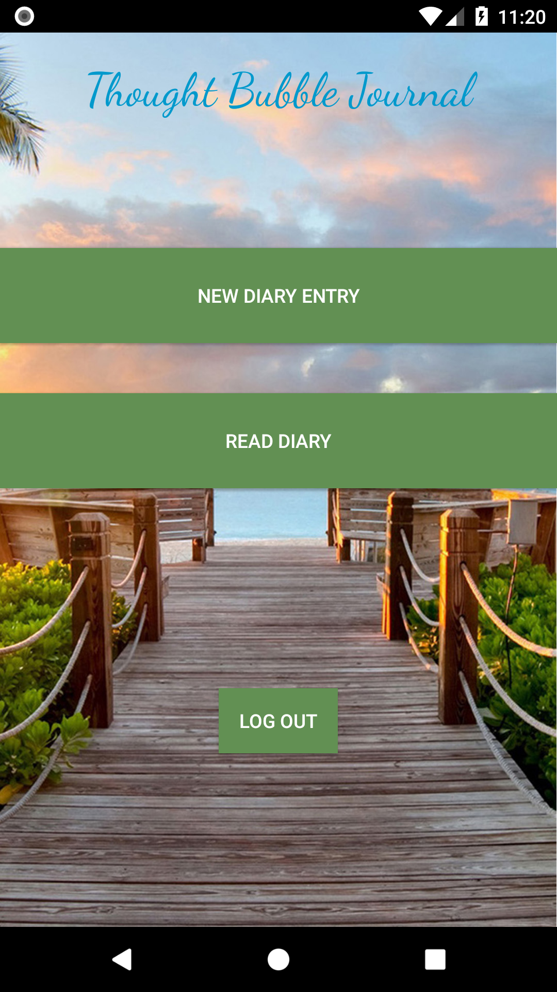
THE LITTLE APP MENU
OPTION 1 – MAKING A NEW PAGE
OPTION 2 – Read your pages
Option 3 – Log out account

Slide 9

making A PAGE IN THE DIARY
CONTENTS ARE ENCRYPTED WITH AES, WHERE THE 256 BIT KEY IS GENERATED FROM THE USER’S PASSWORD SIGNATURE
SAVED WITH TIMESTAMP AND EMAIL ADDRESS

Slide 10
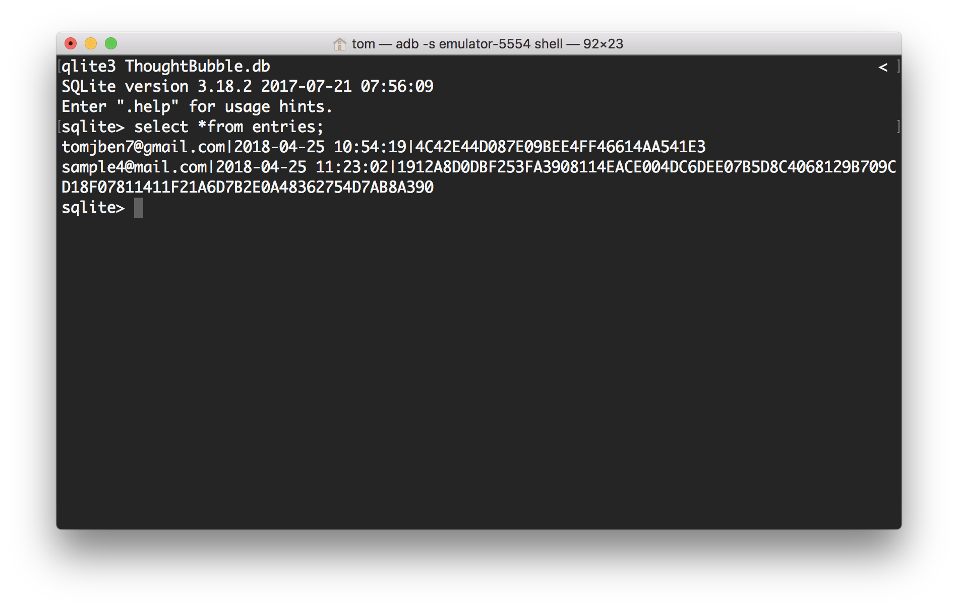

LISTING SAVED ENTRIES

Slide 11

Reading an entry

Slide 12
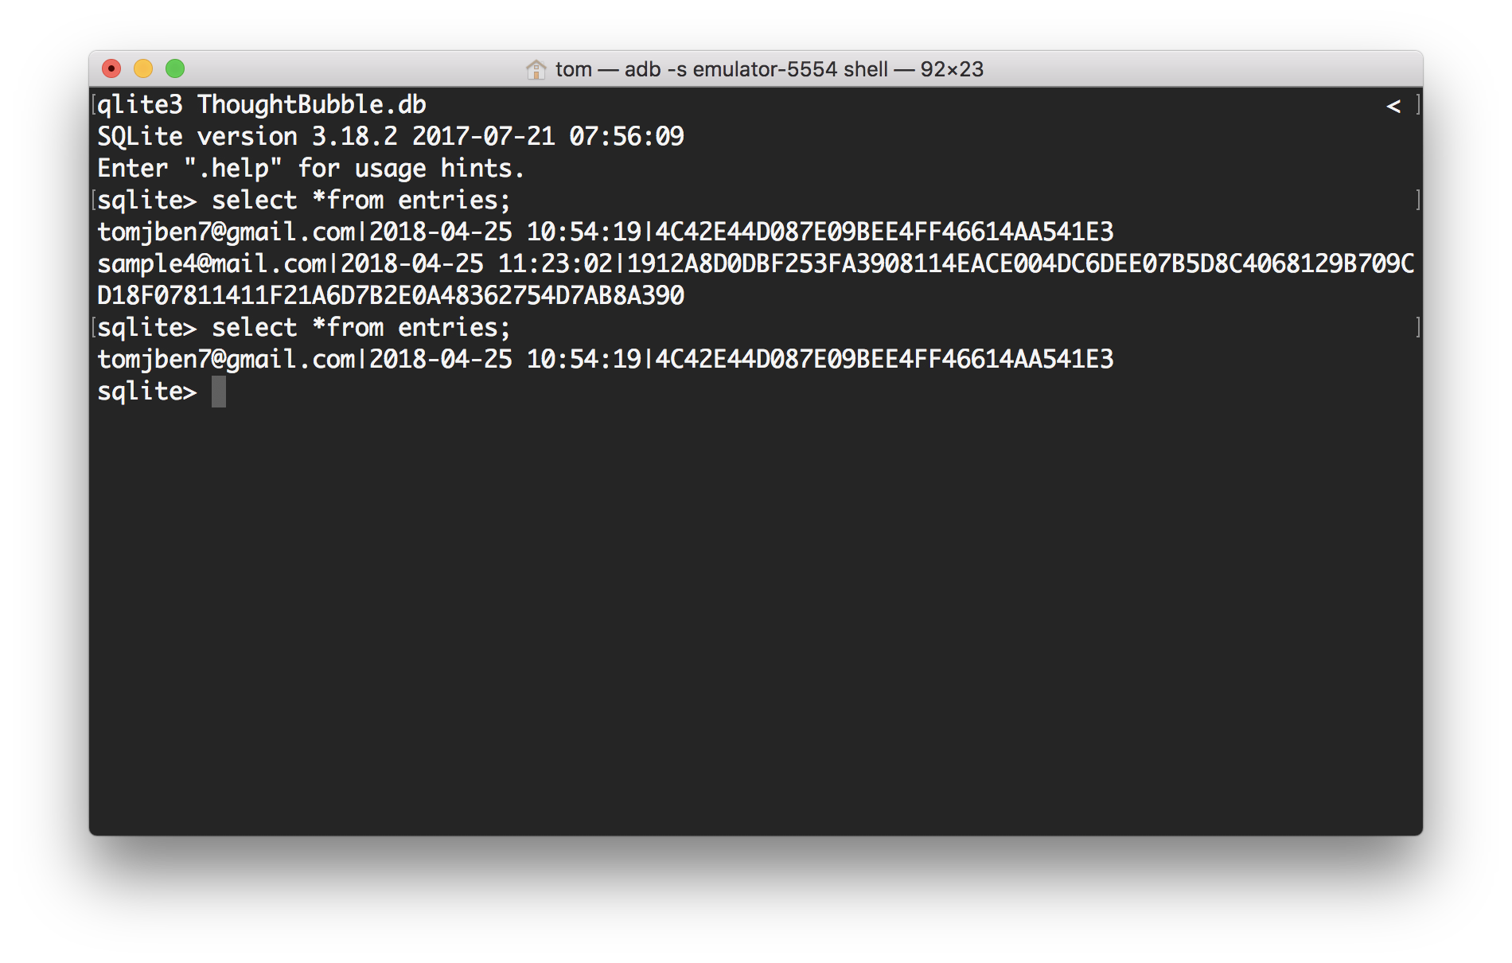
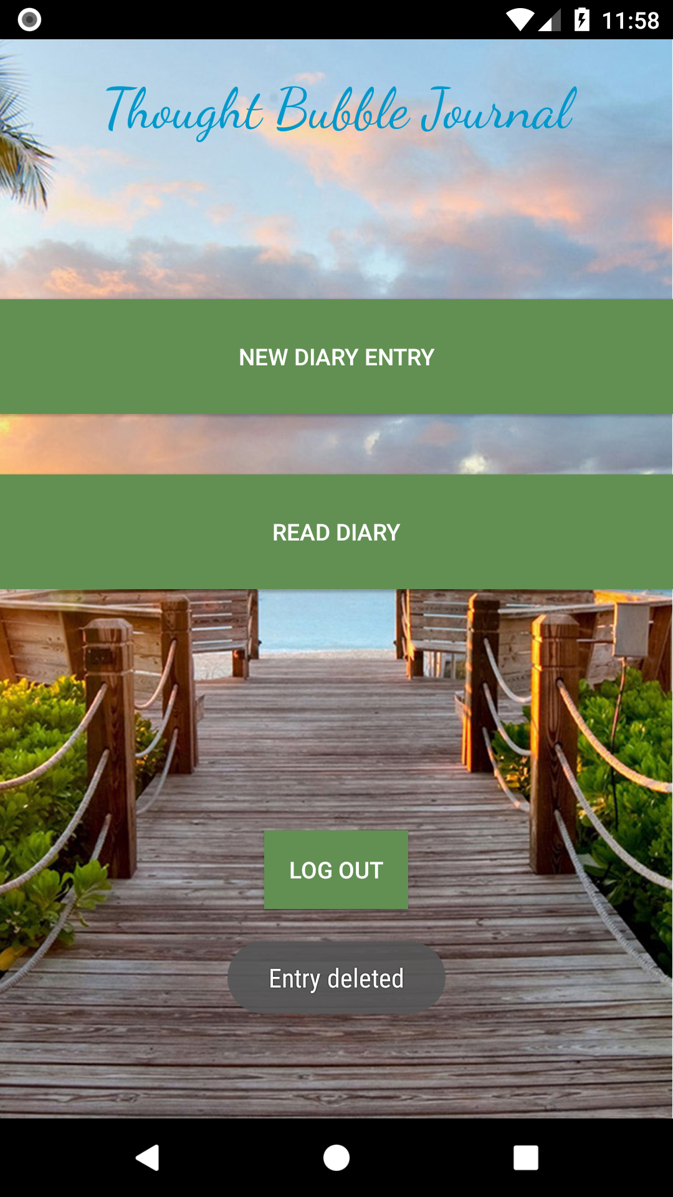
DELETING AN ENTRY

Slide 13
DEMO TIME !!

